Slide 1
Genome-wide de novo prediction of cis-regulatory binding sites in prokaryotes
Shermin Pei

Slide 2
Background
There are only a small part of the cis-regulatory binding sites (CRBS) are characterized in E. coli
Previous attempts to predict CRBSs in E. coli rely on the accuracy of the motif prediction algorithm to find transcription factor binding sites
Newer prediction algorithms incorporate phylogeny information (PhyloNet)

Slide 3
Difficulty
Binding sites are short sequences located in non-coding regions
No pattern to where a binding site can appear
Can not model all protein-DNA interactions to predict the binding site

Slide 4
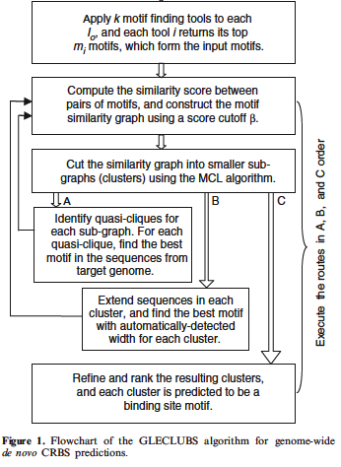
Flowchart: GLECLUBS

Slide 5
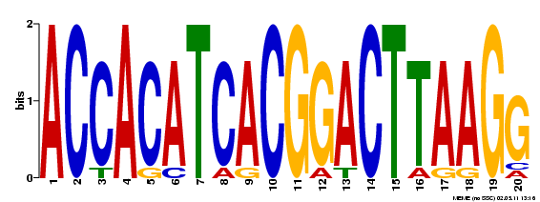
Motif finding programs
MEME
BioProspector

Slide 6
Flowchart

Slide 7
Profile matrix P_{M}
P_{M} = (Prf_{M}(b,i))_{4xL} = (log(p_{M}(b,i)/q(b)))_{4xL}
p_{M}(b,i) = probability of base b appearing at position I
q(b) = background probability of base b

Slide 8

Information stored in a column of P_{M}
Probability of base b at position i
Log(p_{M}(b,i)/q(i))
More likely = higher value
Higher I(I,P_{M}) means that we are more confident of the base b at position i

Slide 9



Self-information
self-information I(ω_{n}) associated with outcome ω_{n} with probability P(ω_{n})
Less likely outcomes will have higher information
Information in a Partitioning C with P(k) being the probability of picking an element in k
Very similar to Entropy = E(I(X))

Slide 10
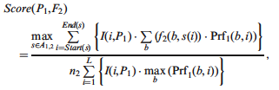
Similarity
Information
frequency
Probability of base b
Select optimal alignment
Upper bound used for normalization

Slide 11
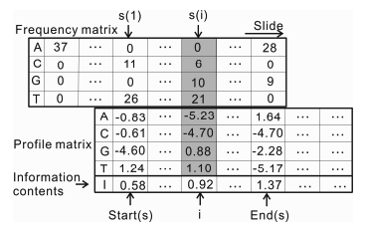
Sliding matrix to find optimal alignment

Slide 12
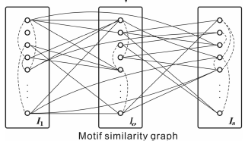
Graph G
I_{o} is set of motifs found given the same starting sequence
Each node is a motif
Each edge connects similar nodes
Edge Weight is motif similarity

Slide 13
Flowchart: Constructing a Similarity graph

Slide 14
Markov clustering algorithm
Van Dongen, S. (2000) Graph Clustering by Flow Simulation PhD Thesis, University of Utrecht, The Netherlands.
Works by using expansion and inflation
Expansion – flow between clusters
Inflation – Strengthens or weakens current cluster
Usually reaches and idempotent matrix
Runs in O(n³) time

Slide 15
MCL pseudo code
G is a graph
add loops to G # see below
set Γ to some value # affects granularity
set M_1 to be the matrix of random walks on G
while (change) {
M_2 = M_1 * M_1 # expansion
M_1 = Γ(M_2) # inflation
change = difference(M_1, M_2)
}
set CLUSTERING as the components of M_1 # see below

Slide 16
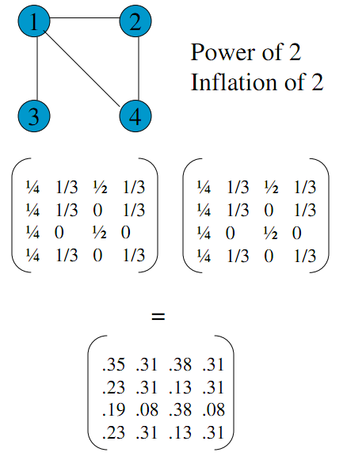
Expansion
Notes:
Markopol http://www.cs.ucsb.edu/~xyan/classes/CS595D-2009winter/MCL_Presentation2.pdf

Slide 17
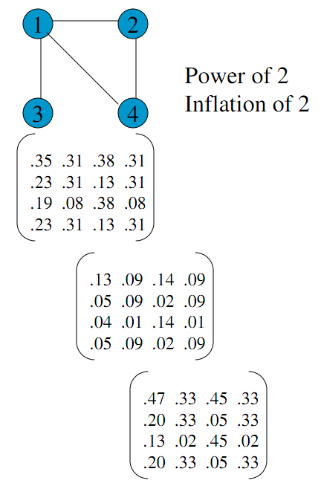
Inflation
Notes:
Markopol http://www.cs.ucsb.edu/~xyan/classes/CS595D-2009winter/MCL_Presentation2.pdf

Slide 18
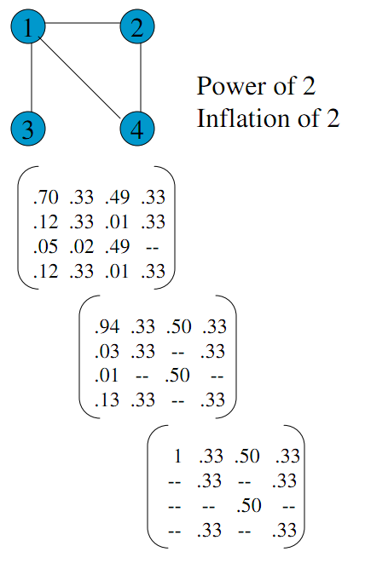
Continue till convergence
Notes:
Markopol http://www.cs.ucsb.edu/~xyan/classes/CS595D-2009winter/MCL_Presentation2.pdf

Slide 19
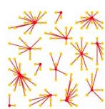
Clusters
Notes:
Dongen, http://www.micans.org/mcl/

Slide 20
Flowchart: Identifying cliques

Slide 21
Finding cliques
Check each node to see if it belongs to a clique
Apply a greedy approach
Deleting a node on the subgraph with the least # of edges
If there is a tie then delete the least weight of edges

Slide 22
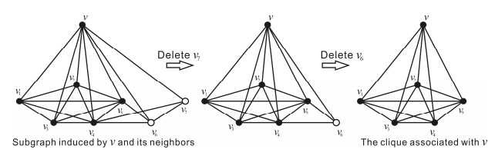
Example of the greedy method to finding a clique

Slide 23

Merge cliques
Merge cliques when ratio of shared nodes is greater than a threshold of:
r_{ab} > .9
R_{ab} > .7

Slide 24
Flowchart: Cluster Ranking

Slide 25

Ranking clusters
Number of seq in best motif
Length of motif
Information in profile P
Number of seq in cluster
Sequences that are common in the cluster and have high information will be highly ranked
Average Information for motif with profile P

Slide 26
Summary
Program takes in best motifs from the motif finders
Profile matrix for each motif is created
Clustering
Finding and Merging cliques
Scoring

Slide 27
Conclusions
Limited by operon prediction and motif finder algorithms
Good ability to filter out false positives
Ranking of clusters provides a good place to start experimental validation

Slide 28
References
Markopol, http://www.cs.ucsb.edu/~xyan/classes/CS595D-2009winter/MCL_Presentation2.pdf, 5/12/2011
Dongen, http://www.micans.org/mcl/, 5/12/2011
Zhang et al. Genome-wide de novo prediction of cis-regulatory binding sites in prokaryotes, Nucleic Acids Research Vol 37, 2009

